Slide 1
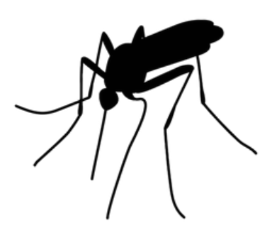

Project 4 - West Nile Virus
Group 4
Soon Zheng Foong
Brandon Loh
Ethan Tye
Tan Wee Hong

Slide 2
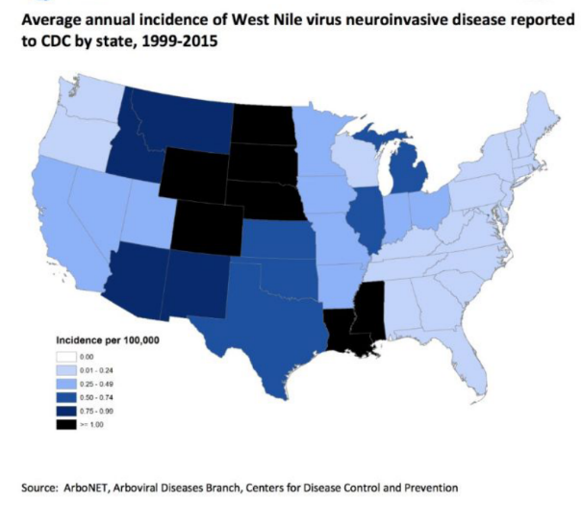
Agenda
Introduction & Problem Statement
Data Cleaning & EDA
Feature Engineering and Importance
Model Selection and Evaluation
Cost Benefit Analysis
Conclusion & Recommendation

Slide 3
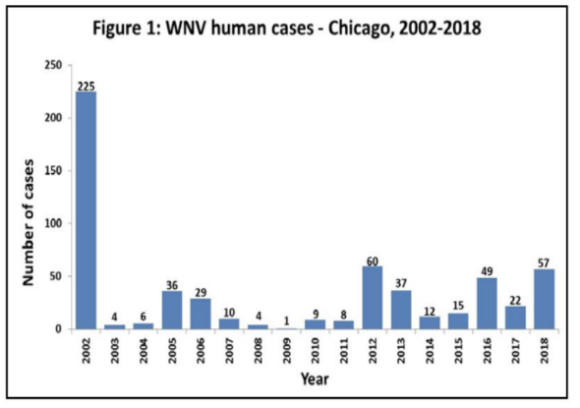
Problem Statement
We are the Chicago department of public health.
Recently, there has been a rise in West Nile
Virus cases and it's becoming a problem for
the public health.
As mosquito control is an expensive exercise,
the state would like our team to propose a cost
effective plan for pesticide deployment.

Slide 4
Data Exploration
Training Data : Trap (Traps records)
>Locations and WNV test results
>Data from May to October; 2007, 2009, 2011, 2013
>Used to predict results from the test 2008 ,2010, 2012 & 2014
Spray Data
>GIS data for spray efforts
>From year 2011 and 2013
Chicago’s Weather Data
>Weather conditions from 2 weather stations
>From year 2007 to 2014

Slide 5
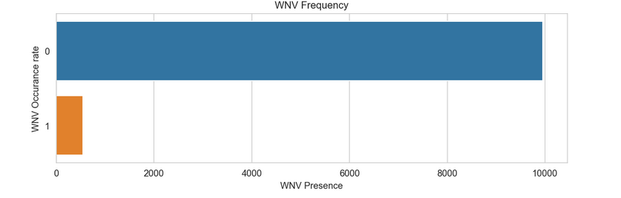

Data Cleaning & EDA
Imbalance dataset

Slide 6
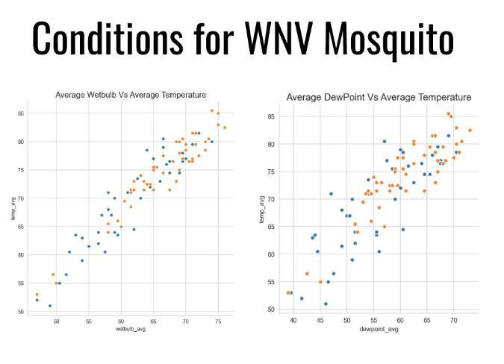
EDA

Slide 7
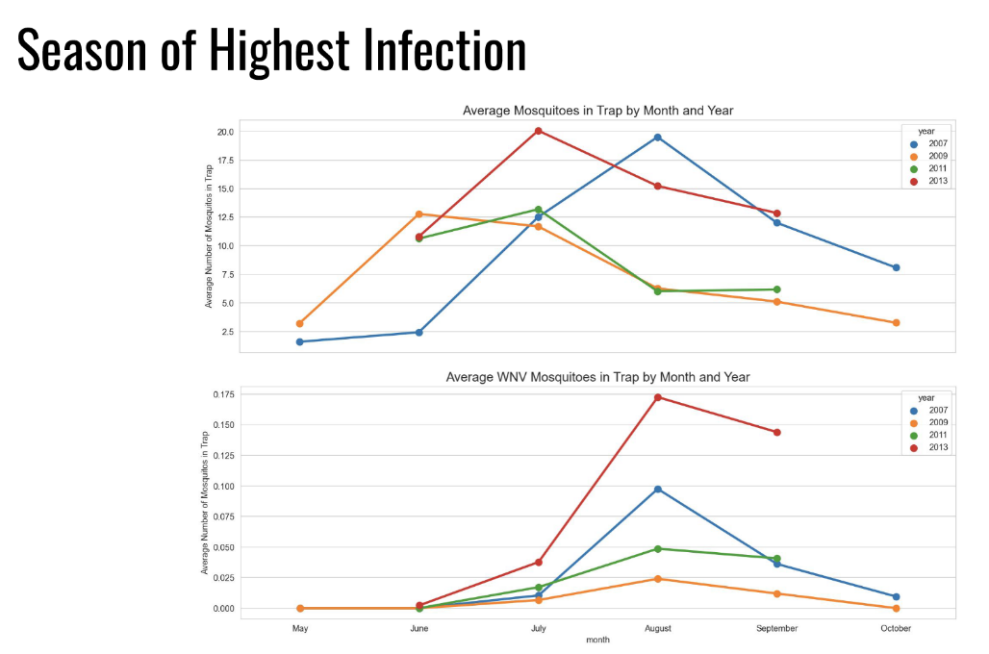
EDA

Slide 8
Feature Engineering
Month_dewpoint
Species_dewpoint
Nightime_dewpoint
CodeSum
Nighttime
This feature contains the
different weather conditions. Rainy and misty Warm, Moist Weather
The number of night time hours. Mosquitos are most active from dusk to dawn.
Polynomial features
1
2
3
4
5
Species
Street & Trap
Re-map to numerical representations
Convert categorical variable into dummy/indicator variables.
Notes:
Warm, Moist Weather- a Mosquito's Friend

Slide 9
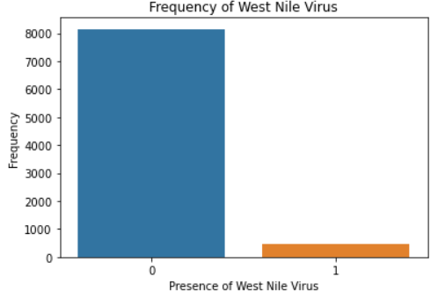
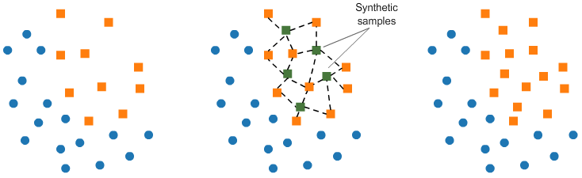
Baseline Model
● Heavily imbalanced data in training set. ~95% of data
● Baseline accuracy : 95% West Nile Virus Not Present
● AUC score will be our main metrics that will help us avoid overfitting to a single class
● Adopt Synthetic Minority Oversampling Technique (SMOTE), a statistical technique that attempts to balance class distribution by randomly increasing minority class examples.
Synthetic Data
Notes:
AUC measures how true positive rate (recall) and false positive rate trade off.
This reveals how good a model is at distinguishing between positive class and negative class.

Slide 10
Modelling
Logistic Regression
XGBoost
Random
Forest
AdaBoost
Notes:
We performed four types of machine learning algorithm, namely, Logistic Regression, Random Forests, XGBoost & AdaBoost.

Slide 11
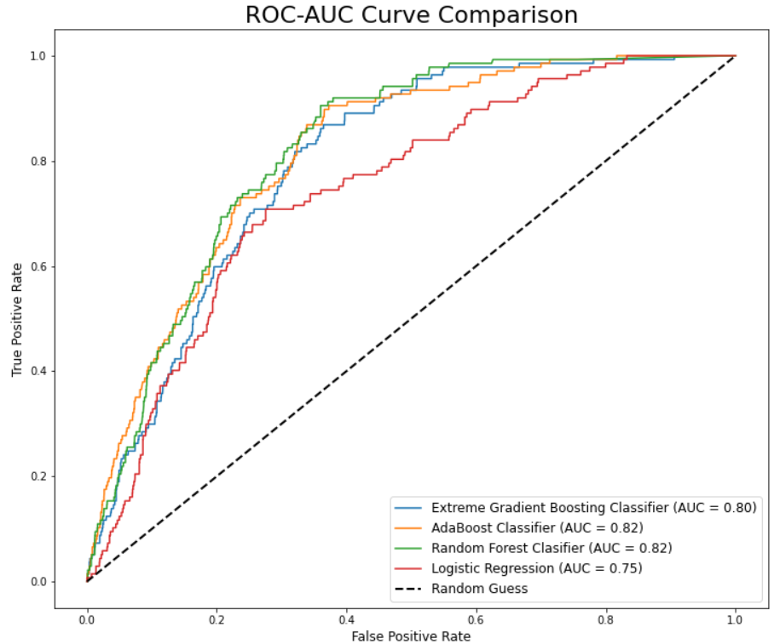
ROC-AUC Curve Comparison
● Our Baseline Model (Logistic Regression) performed the worst.
● In comparison, AdaBoost & Random Forest seem to be performing better in term of AUC.
Notes:
ROC-AUC curve is the measure of the ability of a classifier to distinguish between classes and is used as a summary of the ROC curve. The higher the AUC, the better the performance of the model at distinguishing between the positive and negative classes.
Our Baseline Model (Logistic Regression) performed the worst.
In comparison, AdaBoost & Random Forest seem to be performing better in term of AUC, indicating higher measure of separability..

Slide 12
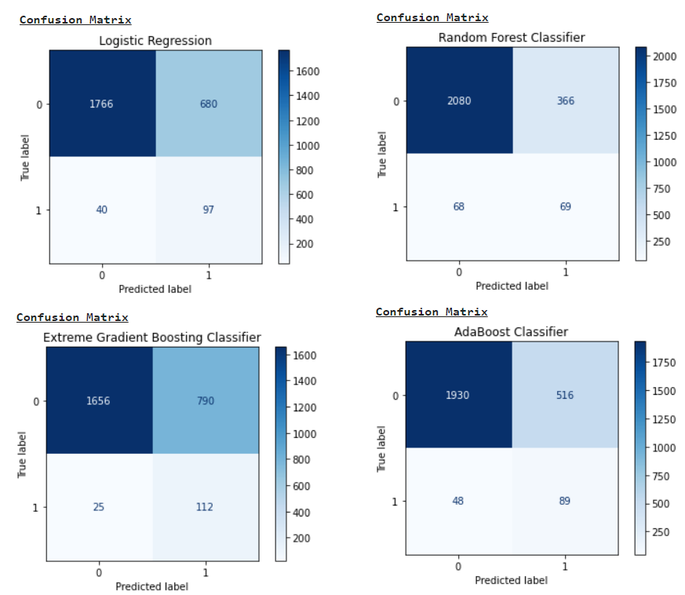
Confusion Matrix
Notes:
XGboost has the lowest number of False Negatives (i.e. predicting that West Nile Virus is not present when it is actually present), which is the most important as it is dangerous to tell the public that a certain location do not have presence of West Nile Virus when there is actually West Nile Virus present. As such, having a very small number of False Negatives is very important.

Slide 13
Model Selection and Evaluation
Model | Train AUC | Test AUC | Precision | Recall | F1 - Score
Logistic Regression (Baseline) | 0.8310 | 0.7466 | 0.1245 | 0.7080 | 0.2118
Random Forest | 0.9900 | 0.8233 | 0.1646 | 0.4745 | 0.2444
XGBoost | 0.9809 | 0.8114 | 0.1242 | 0.8175 | 0.2156
AdaBoost | 0.9358 | 0.8145 | 0.1504 | 0.6642 | 0.2453
Notes:
As our problem is a classification problem and data is heavily imbalance, AUC score and Recall score will be our main metrics here. High recall score relates to a low false negative rate.
Based on our choice of models, XGBoost have A Good Test AUC score, Highest Recall score/Lowest number of False Negatives.
XGBoost AUC score is not the highest, but we decided to prioritize recall score, as ignoring west nile virus could lead to human death.

Slide 14
Cost & Benefit Analysis
We will be performing the relevant analysis on two separate approaches:
Analyzing the current approach taken by the State of Chicago in "containing" the WNV virus as the baseline approach
Compare it with our data-driven approach, which we believe is a more preventive approach rather than reactive
Every week from late spring through the fall, mosquitos in traps across the city are tested for the virus. The results of these tests influence when and where the city will spray airborne pesticides to control adult mosquito populations. We will next analyze the spray dataset given and hopefully it gives us some validation to the statement here.

Slide 15
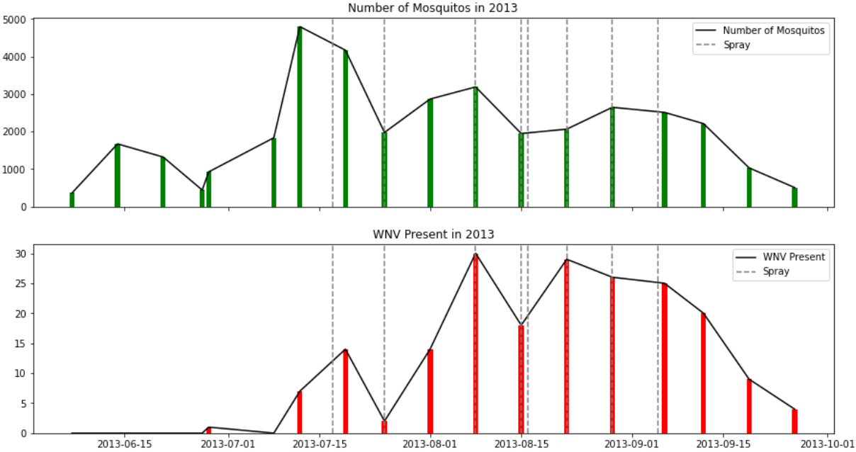
Cost & Benefits Analysis
Current Approach

Slide 16
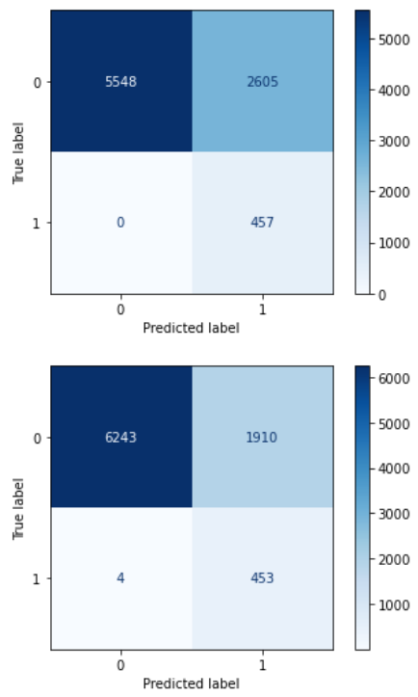
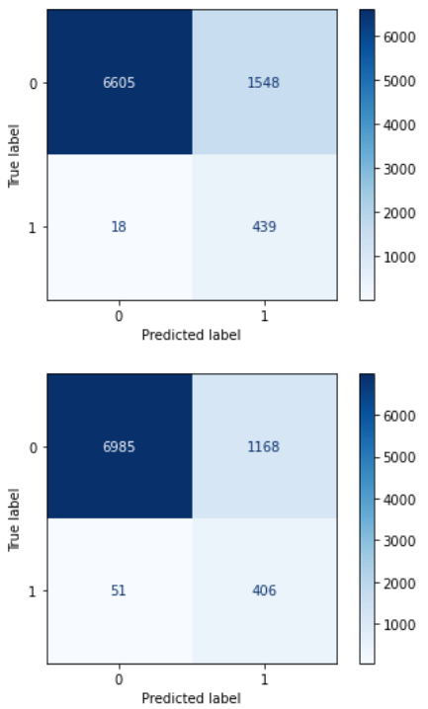
Cost & Benefits Analysis
Data-Driven Approach
Threshold = 0.25
Recall score = 1.0
Precision score = 0.149
Threshold = 0.4
Recall score = 0.99
Precision score = 0.19
Threshold = 0.5
Recall score = 0.96
Precision score = 0.221
Threshold = 0.6
Recall score = 0.888
Precision score = 0.258

Slide 17
Cost & Benefit Analysis
Baseline Approach:
Taking reference from the spray dataset in year 2013, there is a total of 12626 spray points
Assuming a price of Zenivex E4 used is $1.0 per acre and making simple assumption of 100 acre area of coverage for each spray, this would cost approximately USD1,262,600
This approach is targeted and avoid aimless spray of adulticide. However, there is a time-lag issue and it is a more reactive strategy.
Data Driven Approach:
Assuming all the data points available in the training dataset are location of concern and we performed a “back-testing”
We picked a threshold of 0.25 leveraging on XGBClassifier to run it against all data points in training dataset and extract the locations which we predicted as positive (both true and false positives)
The above predicted data points would be the area targeted for spray. Using that as inputs, 3062 locations have been identified
This approach is more preventive and it kills the time-lag issue. However, as the focus was more on recall score, higher false positives has to be accommodated.

Slide 18
Conclusion - Model
Strengths:
Model used - XGB
As our primary goal is to prevent outbreaks, lowering the classification threshold to 0.25 will reduce our FNs at the expense of a small decrease in TPR.
With an AUC of 0. 8 we are confident that the model is able to accurately predict potential clusters while minimising risk of False Negatives.
Weaknesses:
Some False Positives will have to be accepted

Slide 19
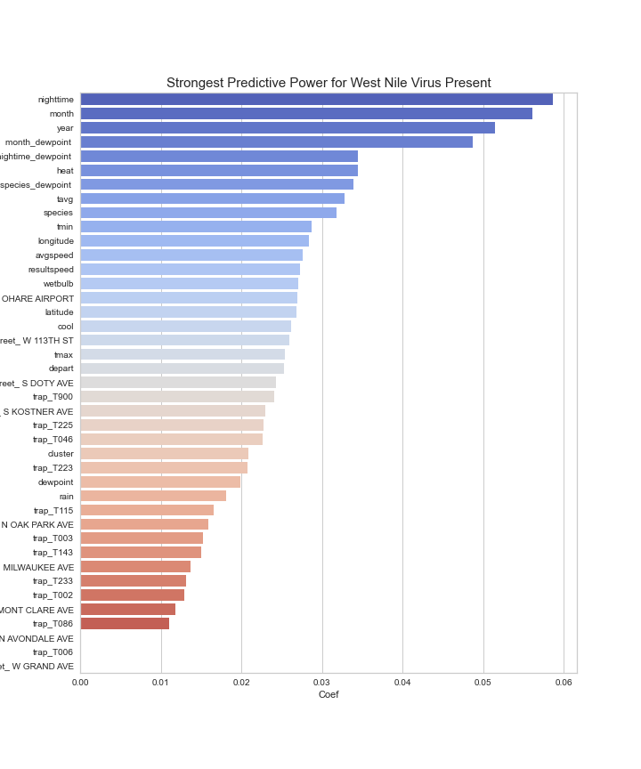
Conclusion - Important Features
Correlation coefficients highlight several seasonal and location features that are strong predictors for the presence of West Nile Virus.
Presence of WNV is most strongly correlated with the duration of nightime
Notes:
Over the course of our modelling and cost analysis, we can conclude that fogging is an effective short term tool to keep mosquito populations controlled. When we plot the regression coefficients we can see that several features that are specific to location such as trap number and street.

Slide 20
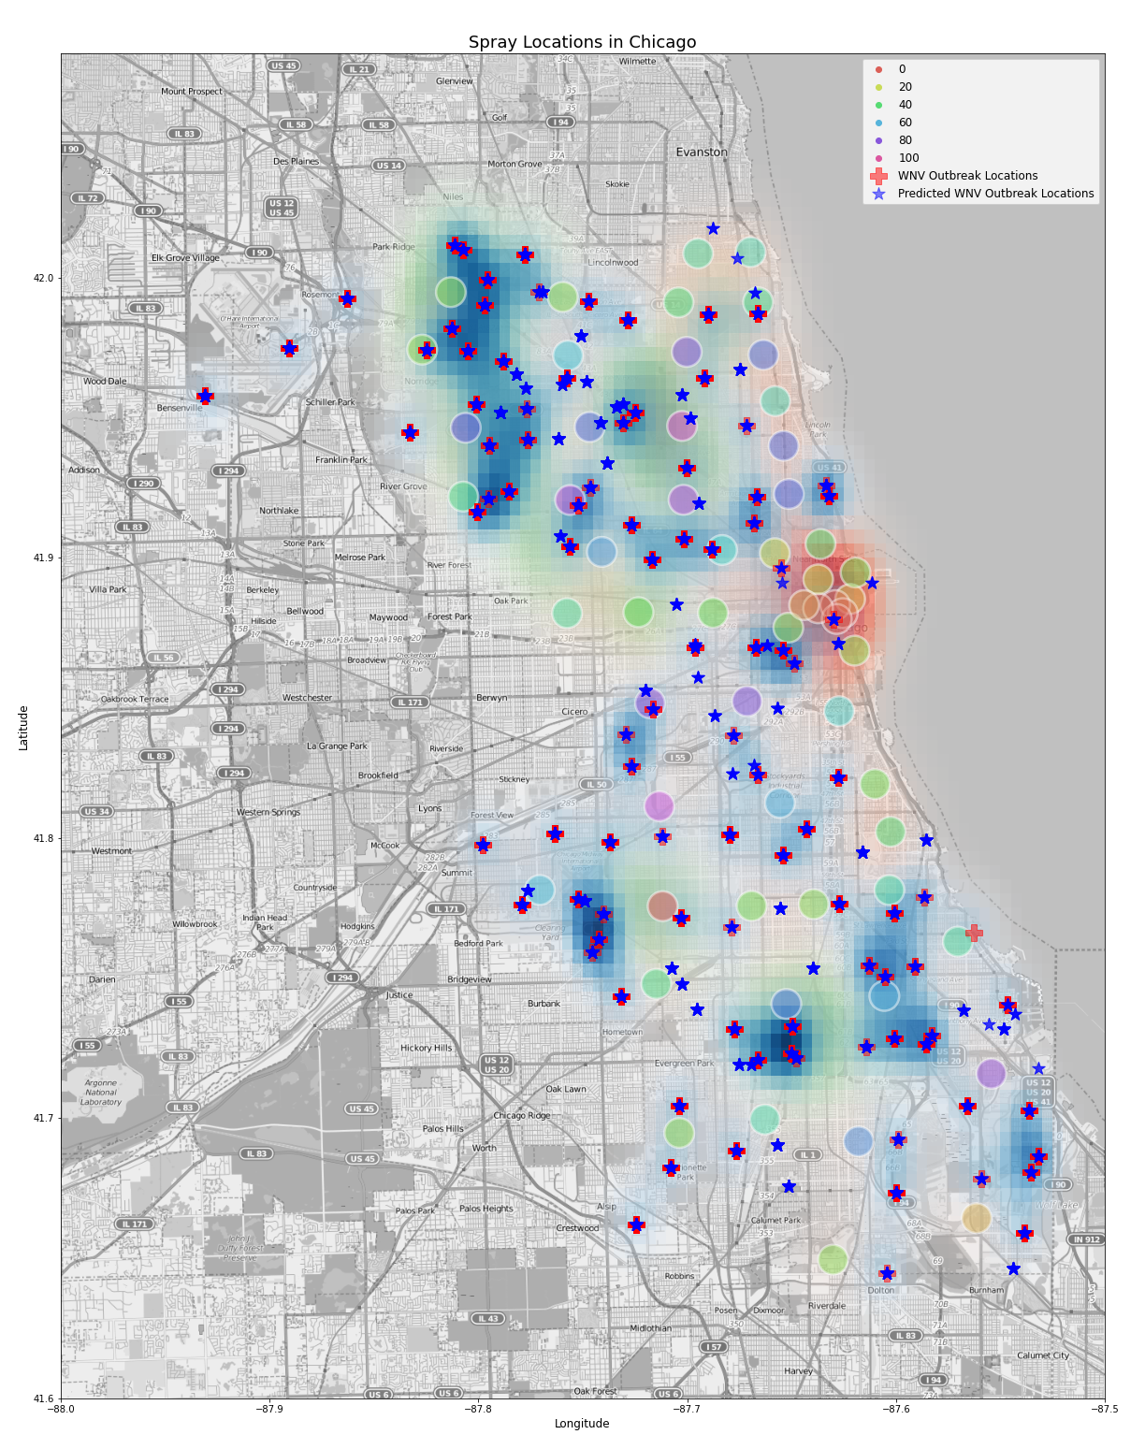
Recommendations
WNV spots that are away from populated areas should be skipped
Based on existing data the spray area in the northern portion of Chicago is ideal as it effectively covers several population centres and wnv hotspots.
To extend protection in this area frequency of fogging should be increased to cover the entirety of summer into mid September when temperatures start to fall.
Other vector controls can be considered to remove breeding habitats between the months of May to June to prevent breeding.
Fogging activities should be expanded to cover hotspots in the southern portion of Chicago where there are several spots where the model predicts WNV that fall within population centres.
Trap density in downtown Chicago is relatively low considering that a significant number of people work/reside in the area more traps should be put in the area to accurately assess the risk in the area.
Notes:
From the previous slides the most important takeaways are:
Pesticides appear to have a short term impact on mosquito populations.
In the absence of pesticides mosquitos activity is driven by seasonality and lastly wnv presence is more frequent in certain locations.
So the main benefit of spraying insecticides is the potential to prevent WNV outbreaks. On average, prevention is expected to save about $33k in medical bills per person.
Considering this our recommendations has to also factor in benefits and cost to Chicagonians.
As such our recommendations are
Increase the frequency of pesticide spraying covering the period from June to September
Extend fogging area to include the ‘southern portion’ of Chicago
Increase the number of traps in the city centre

Slide 21
Questions?

